Slide 1

Introduction to Embedded Systems
Course Code: 244066
Lab 1
General IO ports of STM32
By
Dr. Muhammad Imran Nadeem
Zhengzhou University

Slide 2
Instructions:
Complete every task in the lab practice session.
For each task, include a 2–5 line description along with a screenshot of both your code and its output.
Submit your lab report by email to Imran.Nadeem@outlook.com, using the subject line format: ES24-[lab number]-[registration number].
Submissions received after the deadline will not be accepted.

Slide 3
Overview
Overview of Learning Outcomes
By completing these simulated labs, you will:
  Configure and monitor GPIO registers (MODER, IDR, ODR, PUPDR).
  Visualize GPIO operations without hardware.
  Understand digital input/output logic and timing.
  Develop bit manipulation and register-level coding skills.
  Gain debugging experience using Keil’s Watch & Peripheral views.

Slide 4
Task 1: LED Blinking Using ODR
Learn to configure GPIO pins as output and toggle them through the Output Data Register.
Steps
  Create a new STM32 project.
  Enable the GPIOC clock and configure PC13 as output (MODER = 01).
  Write a loop to toggle GPIOC->ODR ^= (1 << 13);.
  Insert delay using a for-loop.
  Run in Debug mode → open View → Peripherals → GPIO → GPIOC.
  Observe ODR[13] toggling between 0 and 1.
Output: ODR bit 13 toggles periodically — simulating LED ON/OFF.

Slide 5
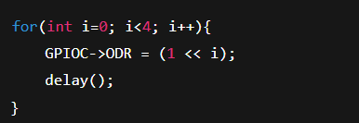
Task 2: Flowing LED Pattern (Running Light)
To simulate a running LED pattern using multiple GPIO pins through ODR bit shifting.
Steps
  Configure pins PC0–PC3 as output.
  Write loop:
3. Add Watch Window → GPIOC->ODR.
4. Run simulation → observe ODR values change:
0001 → 0010 → 0100 → 1000 → repeat.
Output: Binary value in ODR shifts left each time — representing a running light pattern.

Slide 6
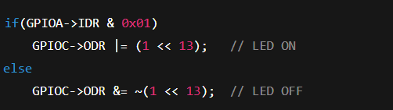
Task 3: Button-Controlled LED (Input Mode Simulation)
To simulate reading an input pin (button) and controlling an output (LED) using IDR and ODR registers.
Steps
  Configure PA0 as input and PC13 as output.
2. In Debug mode → open GPIOA peripheral window.
3. Manually toggle IDR[0] to simulate button press (0→1).
4. Observe ODR[13] change accordingly.
Output: When IDR[0] = 1 → ODR[13] = 1 (LED ON).
When IDR[0] = 0 → ODR[13] = 0 (LED OFF).

Slide 7
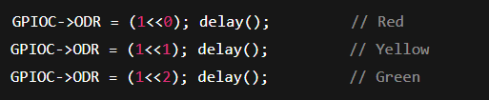
Task 4: Software Traffic Light Controller (State Logic Simulation)
To simulate a simple traffic light sequence using software delays and GPIO outputs.
Steps
  Assign:PC0 → Red, PC1 → Yellow, PC2 → Green
  In main loop:
  Observe ODR values in Watch Window.
  Verify the pattern repeats in the sequence (Red → Yellow → Green).
Output: ODR values change as 0001 → 0010 → 0100 cyclically.

Slide 8
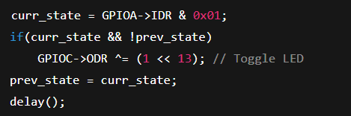
Task 5: Edge Detection (Polling Simulation)
To detect a change (edge) in an input signal through software polling using IDR.
Steps
  Configure PA0 as input and PC13 as output.
  Store previous button state variable prev_state.
  In loop:
  In simulator → toggle IDR[0] manually.
  Observe LED toggle each time input transitions from 0→1.
Output: LED toggles once per simulated button press (edge-triggered behavior).

